Slide 1
GNU Health on openSUSE
Insights into a global, diverse and friendly community openSUSE Conference
Prague, 26.05.2018
Dr. Axel Braun
DocB@opensuse.org
abraun@gnusolidario.org

Slide 2
What is GNU Health?

Slide 3

GNU Health – Freedom and Equity in Health

Slide 4

GNU Health: Functional areas
Person and Community
Person, family, Socioeconomics, lifestyle ...
Domiciliary Units, Operational Areas, Institutions,…
Patient
EMR, Evaluations, Genetics, prescriptions, History, surgeries…
Health Institution Management
Hospitalizations, Finances, Laboratory, stock, HR, ..
Health Authorities / MoH
Health campaigns, epidemiology, ...

Slide 5







GNU Health is free/libre software
Freedom to run , adapt, improve and redistribute

Slide 6
The Community

Slide 7
Who is ‘The Community’?
Foundation
Makers
Users

Slide 8
The easy part - Foundation
Remember the ‘Free Software’ slide?
GNU Health builds on top of
Python 3
PostgreSQL
Tryton
Flask
...and runs on free systems like FreeBSD or GNU/Linux

Slide 9
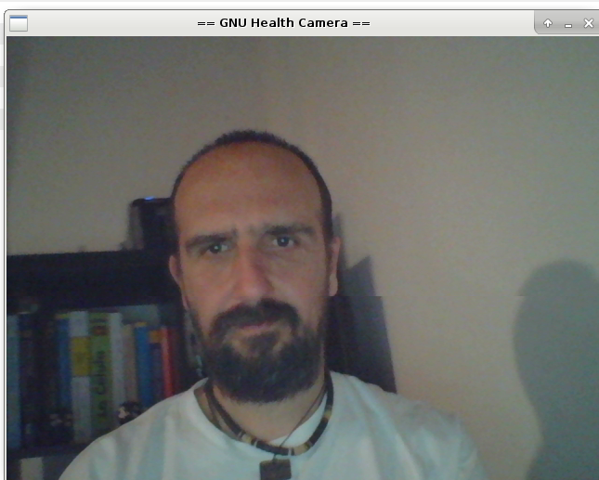
And who did the job?
For the most part:
Dr. Luis Falcon
Software Engineer and
Medical Doctor
(you will meet him in the next presentation)

Slide 10
The Users

Slide 11
The difficult part - Users
The issue with Free Software Projects
We dont know our Users!
(at least for the most part)
Notes:
No need to register, sign contracts or pay fees
No home-phone
So how to measure installations/ users?
Only parts of projects known covering wide range of use

Slide 12
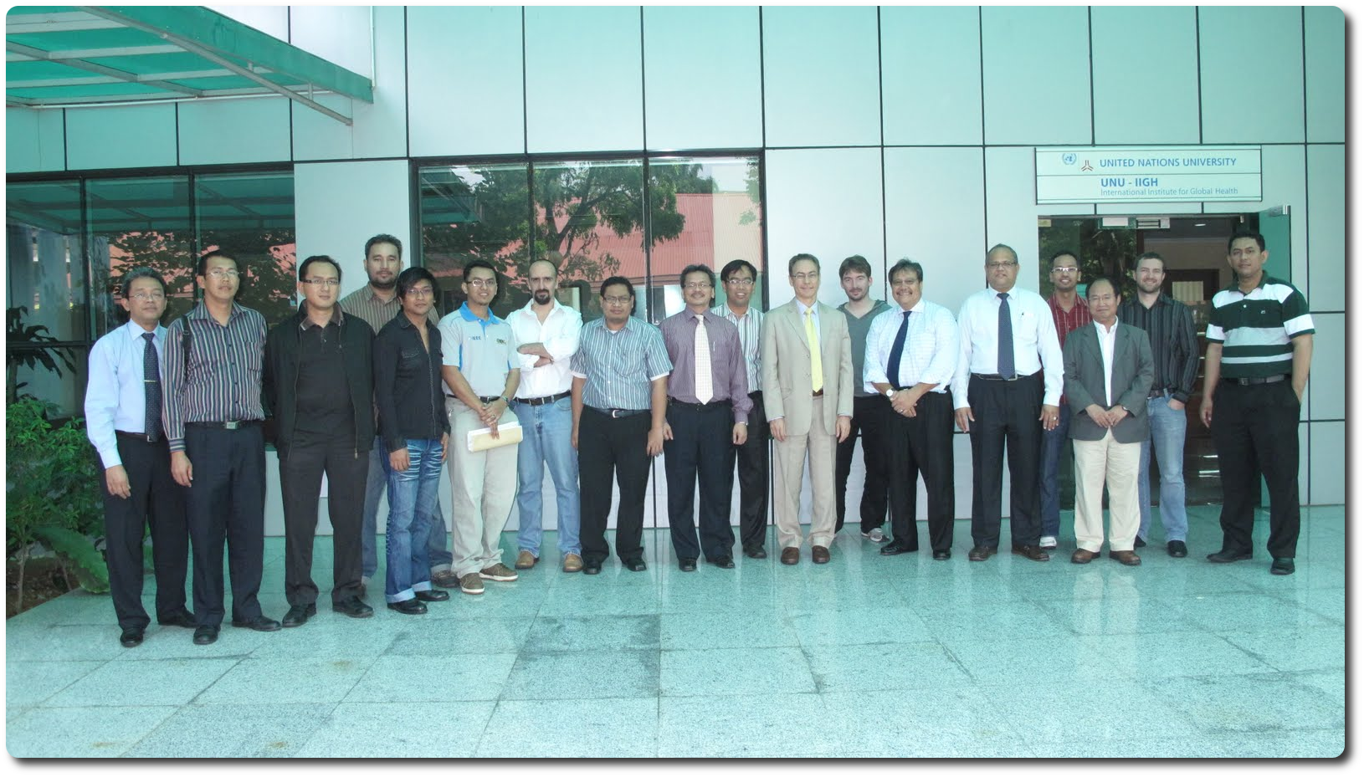
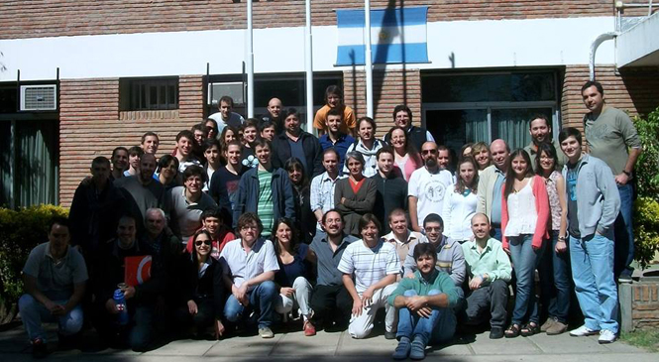
Users: Academia
United Nations University, Kuala Lumpur,Malasia
University of Entre Rios, Argentina
Notes:
- Education
- Nursery school
- Assistance (treatment)
- Laboratory
- future – additional development?

Slide 13

Users: Academia
Notes:
New – Insolafrica NGO from Spain
Insolàfrica is a non-profit organization, officially formed in 2011 by health professionals united in a common way of seeing solidarity and cooperation.
The area of action focuses on Sub-Saharan Africa, and specifically on Cameroon. The areas of action of Insolàfrica are the following:
Training of health professionals;
supply of sanitary equipment to different centers of the zone;
improvement of health infrastructures and humanitarian aid.

Slide 14
Users: Known implementations
Notes:
Red – the ones we know
Yellow – on the way resp. planned

Slide 15
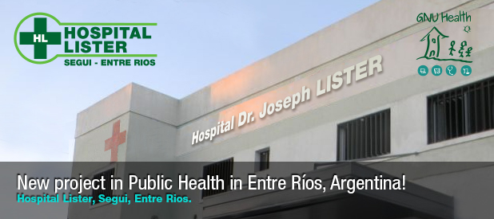
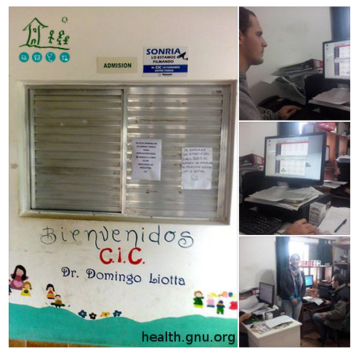

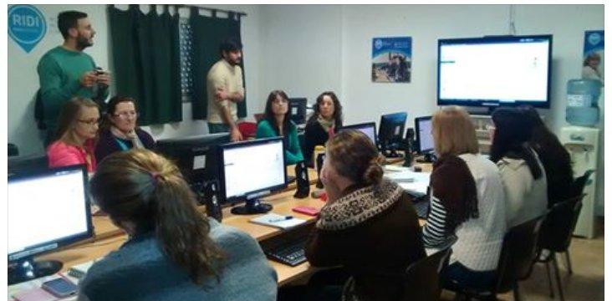
Argentina Public Health System
Province Entre Dos Rios
Since 2012, 8+ installations
Primary Care/Day Care
Notes:
Argentina was the country with the first implementations, as development started in BA
CITY: SEGUÍ (ENTRE RÍOS)
BEDS: 6
POPULATION: 6000 PEOPLES
Specialities : 7
LABORATORY: YES
Professionals : 25
EMERGENCY: YES

Slide 16
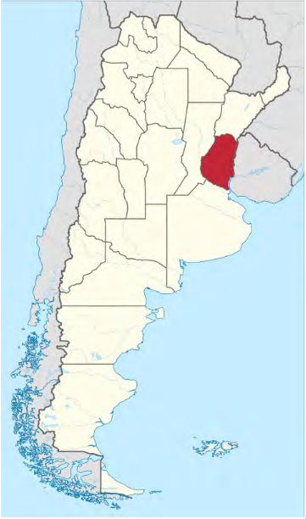
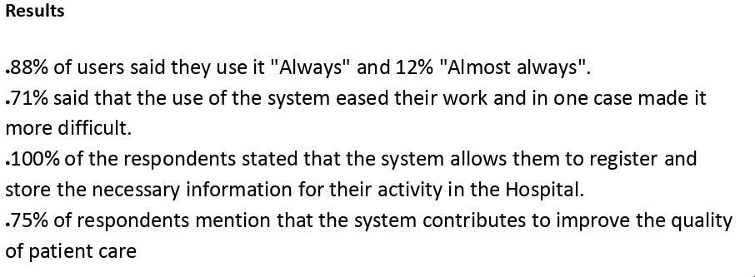
Argentina Public Health System
Province Entre Rios
Since 2012, 8+ installations
Primary Care/Day Care/Hospital
Notes:
"Technology for the administration of health care“
Objective: "Promote the use of technologies based on free software for data processing and health information in organizations related to public health"

Slide 17
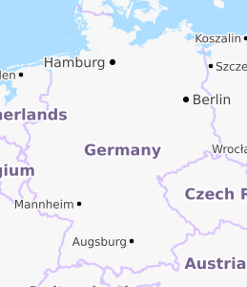
Daycare for homeless, refugees and persons without health insurance, Germany
Runs GNU Health since 2017 (migrated from openEMR)
Daycare center
4 nurses, 8 doctors
Monthly event with meals, medical and consultingservices (debt, drug, etc)
40-80 visitors per event, 10-15 asking for med care
Budget: 0
Notes:
The „Malteser Pflasterstube“ is a network of volunteers which offers medical care to homeless people or people without heath insurance.
Once a month the network organizes a meal with medical care, consulting services (debt, alcoholism, drug addiction) and other services (hair cut and others). Everything is free and discrete.
On such a monthly event there are between 40 and 80 visitors. 10 to 15 are asking for medical care.
The network gives 24/7 support if someone calls the emergency number and asks for help.
As software we used for three years OpenEMR and changed 2017 to GNU Health.

Slide 18
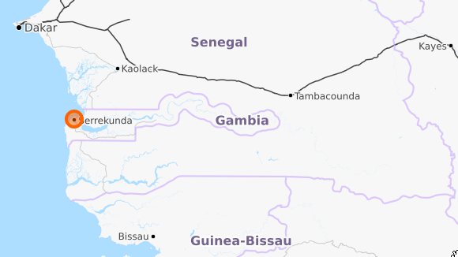
Sharab Medical Center Gambia
Runs GNU Health since 2016
14 beds
40 professionals
40 patients per day
Moved fom GH 2.8 (Ubuntu)
to 3.2 on openSUSE
http://www.sharabclinic.com/
Notes:
GNUhealth 2.8 was first implemented by an outsource in the beginning of 2016, it was not practically functional till an IT staff was available on board on Sep 2016.
Training and putting procedures were on going. updates to versions 3.0 and 3.2 were on openSUSE by packages through support of Dr Axel Braun and It was more responsive than the previous versions on Ubuntu.
Currently the system is absolutely helping us to provide better services efficiently.

Slide 19
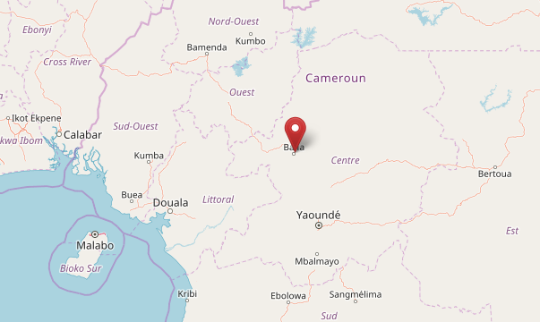
Bafia District Hospital Cameroon
GNU Health since 2018
170 beds
110 professionals
50-100 patients per day
3 month prep &
2 month implementation
Notes:
GNU Health was successfully implemented. It took 3 months preparatory works and 2 months deployments.

Slide 20
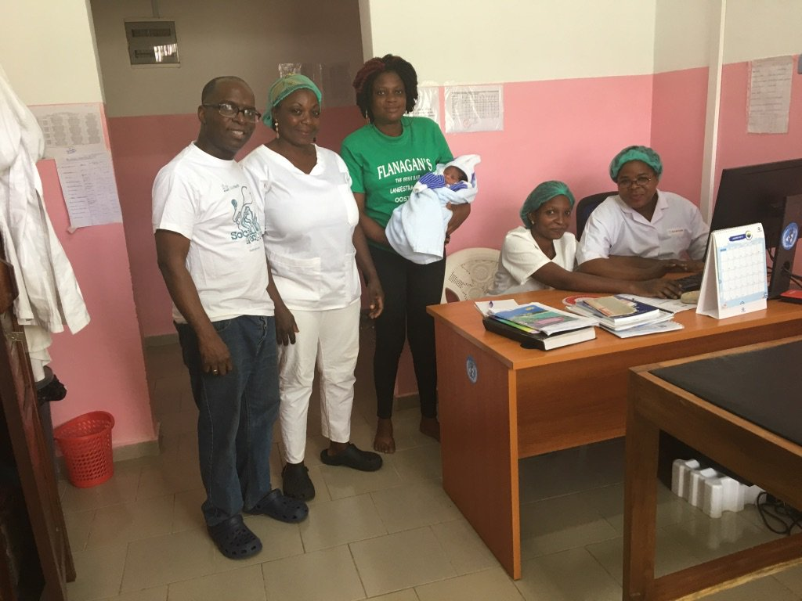
Bafia District Hospital Cameroon
Project in partnership with
WHO and MoH Cameroon
Challenges:
Infrastructure
(Regular power cuts)
low computer literacy
Notes:
Success factors: Motivated staff and leadership, well trained health professionals, good partnership with WHO and the MoH of Cameroon, project labeled as WHO project,
implementation process based on processes and not based on functionalities, we sold a business and health solution not a software,
We focus on finding solutions to the health and managerial challenges of the hospital, training was customized based on the needs of each staff,
special transition from sandbox to production platform, stable and reliable Os (OpenSuse Leap) and code (Tryton and GNU Health) which reduces the level of maintenance, very few or almost no customization to reduce the costs and the implementation time

Slide 21
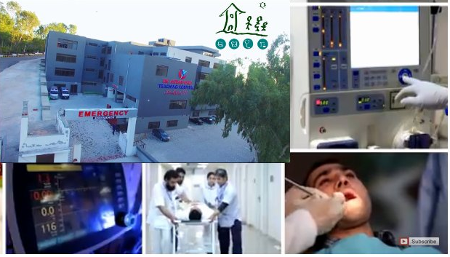
Dr. Akbar Niazi Teaching Hospital,
Islamabad, Pakistan
Runs GNU Health since 2016
500 beds
150 professionals
250 patients per day
Budget: 0 (Inhouse team)
www.danthospital.com
Notes:
Customized and implemented following modules one by one:
Outpatient registration (OPD)
Appointments, Patient Evaluations, Prescriptions, Lab
Inhouse Team = Education

Slide 22

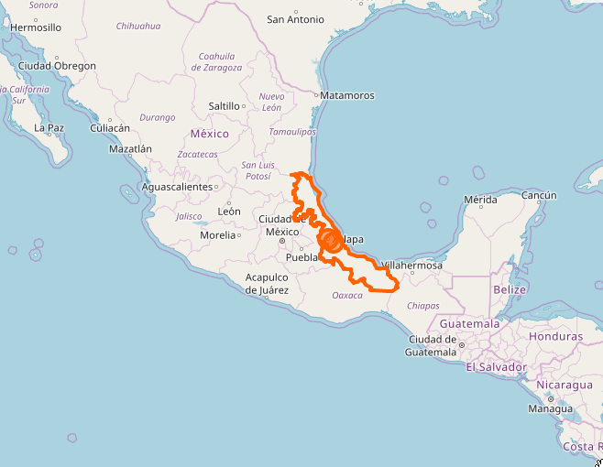
Red Cross Mexico
Runs GNU Health since 2017 in 3 locations in Veracruz, Boca del Rio
24 consulting rooms
36 beds
14 ambulances
340 professionals
850 patients per day
Notes:
Multi-site use

Slide 23
Red Cross Mexico - before
Accounting system does not comply all the needs
No system for inventory control
Only physical medical records
Hospitalization system does not comply all the needs
Good system for emergency calls control but, completly independet to the others
...and some more issues
Manual work
No control
Very difficult to locate clinical history for patients
Manual work
Manual work to transfer information for accounting and some statistics
Notes:
Similar issues on each implemementation

Slide 24

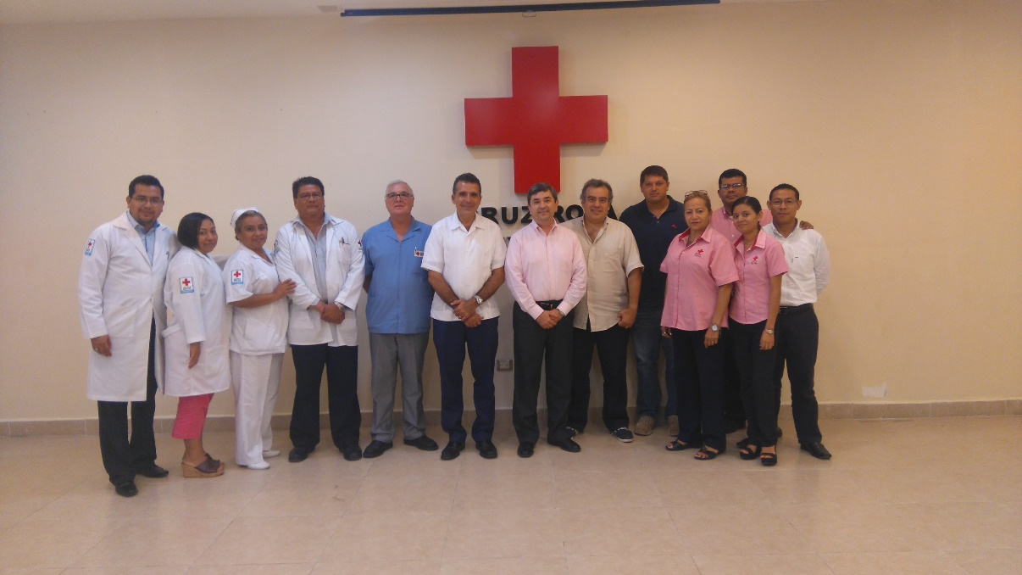

Red Cross Mexico - after
Consulting appointments
Accounting
Surgeries
Inventory Control
Purchase
Electronic Medical Records
Pharmacy (POS)
Hospitalizations
Imagenology
DB
Laboratory
Cash collection
Emergencies
Payments
Notes:
Everything under one roof
Ambulance system was developed in this project, now in the GNU Health standard

Slide 25
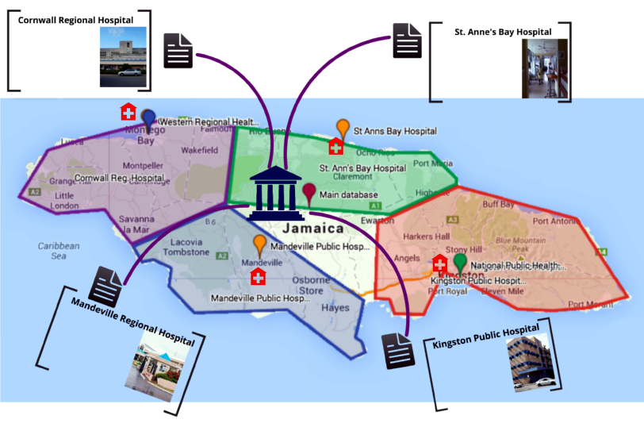
Jamaica Public Health System – 350+ locations
Notes:
- Introduction of the PUID concept
- Basis for the foundation concept

Slide 26
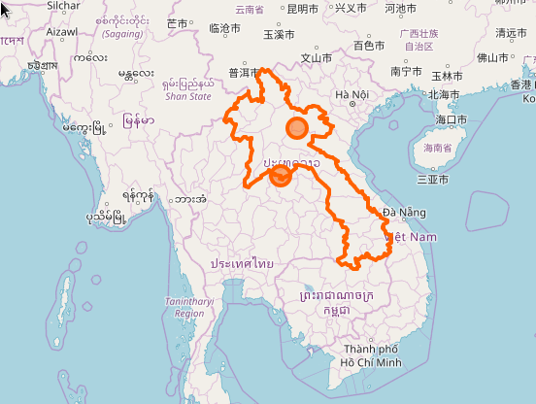
Center for Medical Rehabilitiation (CMR) Laos
Runs GNU Health since 2014
Service for amputees and rehabilitation
Module for health disability
Notes:
Laos is an asian country surrounded by mainly Thailand in the west and Vietnam in the east

Slide 27
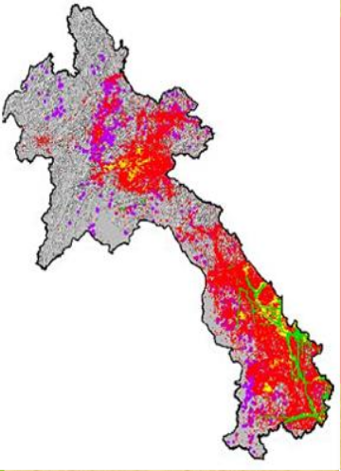
Center for Medical Rehabilitiation (CMR) Laos
Runs GNU Health since 2014
Service for amputees and rehabilitation
Module for health disability
Notes:
During 64-73, B-52 F-aircrafts did 580,000 sorties; Many types of Bombs
two million tons dropped over 2/3 of Laos territory;
30 % of them remain unexploded (unexploded ordnance, UXOs) > WW.II ’s bombing.
Total 148 districts, 42/47 out of poorest districts seriously affected.
Bombing destroyed many villages and displaced hundred thousand of Lao civilians during 9 year period.
Each year there are now just under 50 new casualties, down from 310 in 2008.
Close to 60% of accidents result in death, and 40% of victims are children
Over 25 years on, less than 1% of these munition have been destroyed.

Slide 28
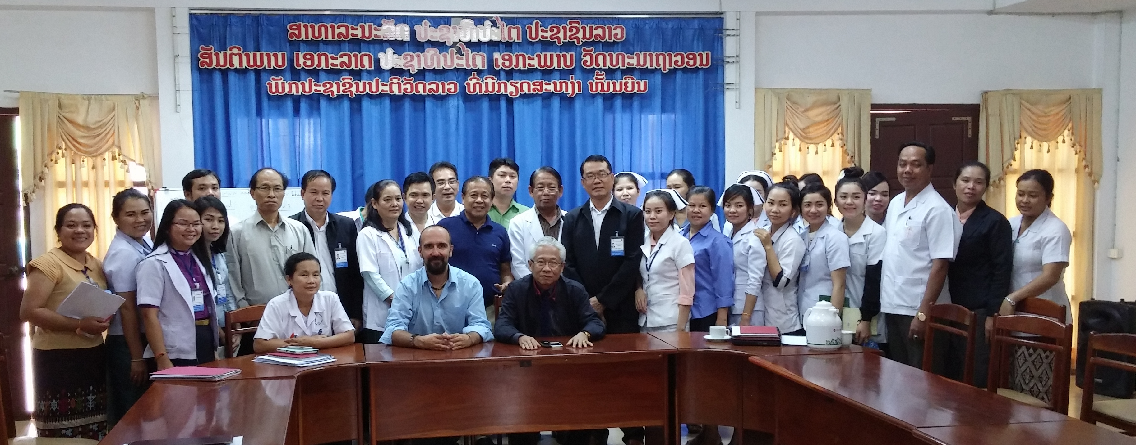
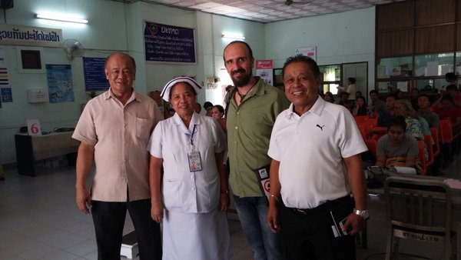
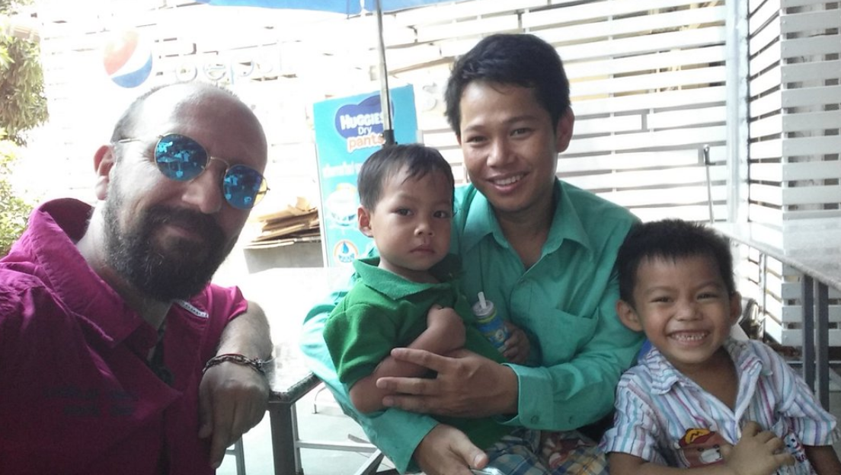
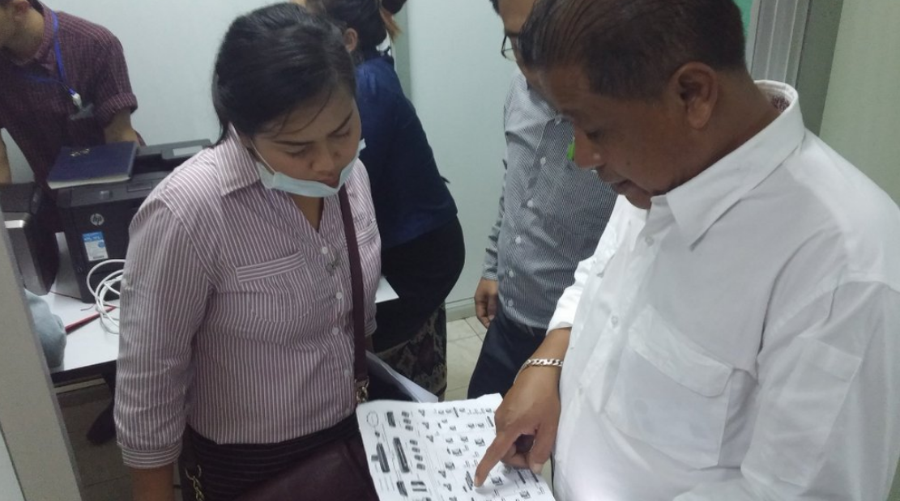
Center for Medical Rehabilitiation (CMR) Laos

Slide 29
Mahosot Hospital Vientiane, Laos
Runs GNU Health since 2016
Old & complex building, partly since french colony
600 beds
Completed translation to Lao language
Introduced by same team as CMR

Slide 30
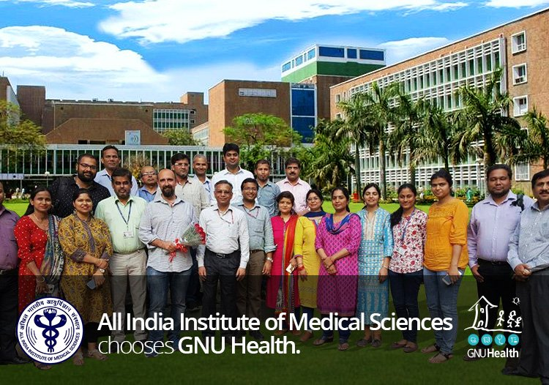

Slide 31
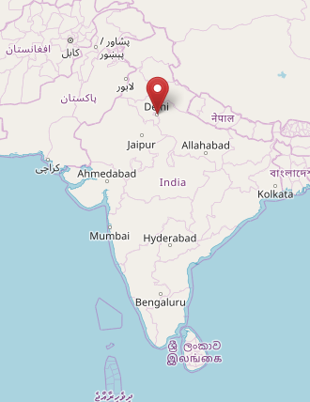
All India Institute of Medical Science
GNU Health implementation in progress
Largest public hospital in Asia
3.500 beds
3.5 Mio examinations/year
70 FTE internal IT staff
openSUSE as backbone

Slide 32
A white spot...
Notes:
Translated to traditional chinese in about three weeks
No feedback about usage

Slide 33
The Makers

Slide 34
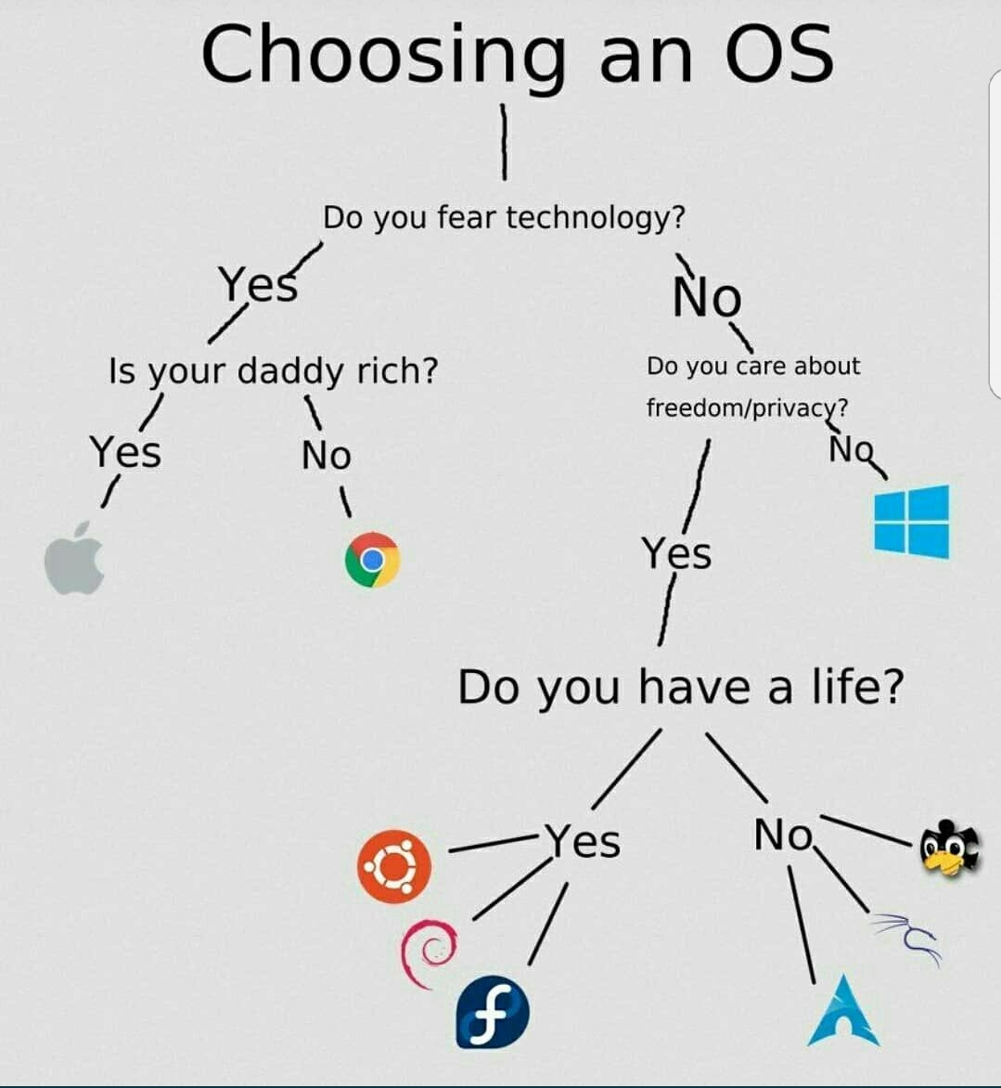

Notes:
Bavarian Data Protection Authority for the Private Sector
Conclusion:
However, there is still no extensive guidance on how Windows 10 can be used in full compliance with
European data protection law.

Slide 35



The Makers – turning source code into packages
Software Installation largest challenge for non-technical users
010011

Slide 36
The Makers
Remember the ‘Free Software’ slide?
GNU Health builds on top of
Python 3
PostgreSQL
mongoDB
Tryton
Flask/Gunicorn
The Makers – that’s YOU!

Slide 37

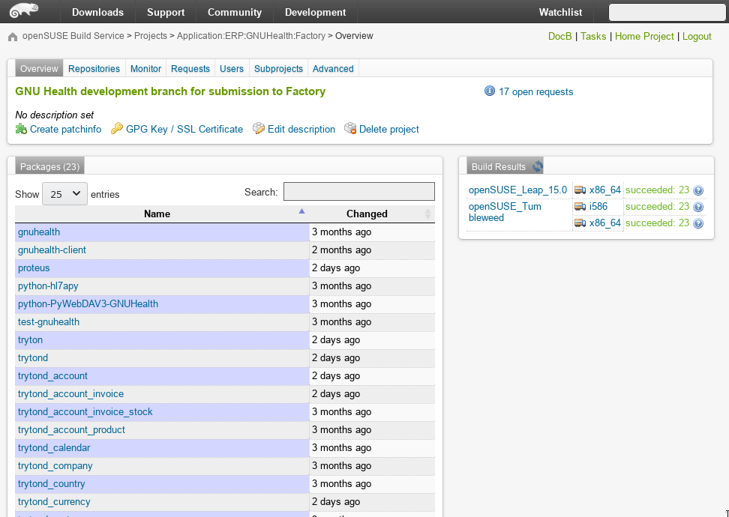
GNU Health on openSUSE - OBS
Application:ERP:GNUHealth
Notes:
Story started 2 years ago at oSC, integration of GH into Leap / Tumbleweed

Slide 38
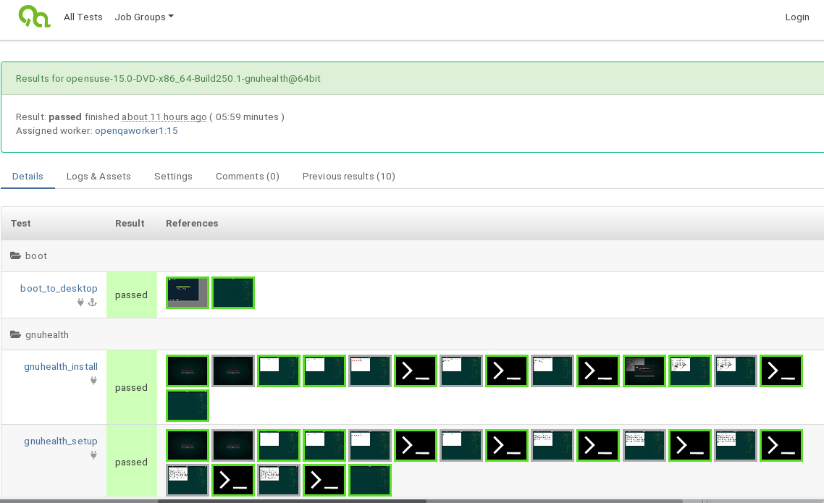
GNU Health on openSUSE - openQA
Notes:
Only Distribution that ships GNU Health in standard and is tested!
Discussed on last oSC and implemented afterwards by Oliver Kurz from SUSE

Slide 39
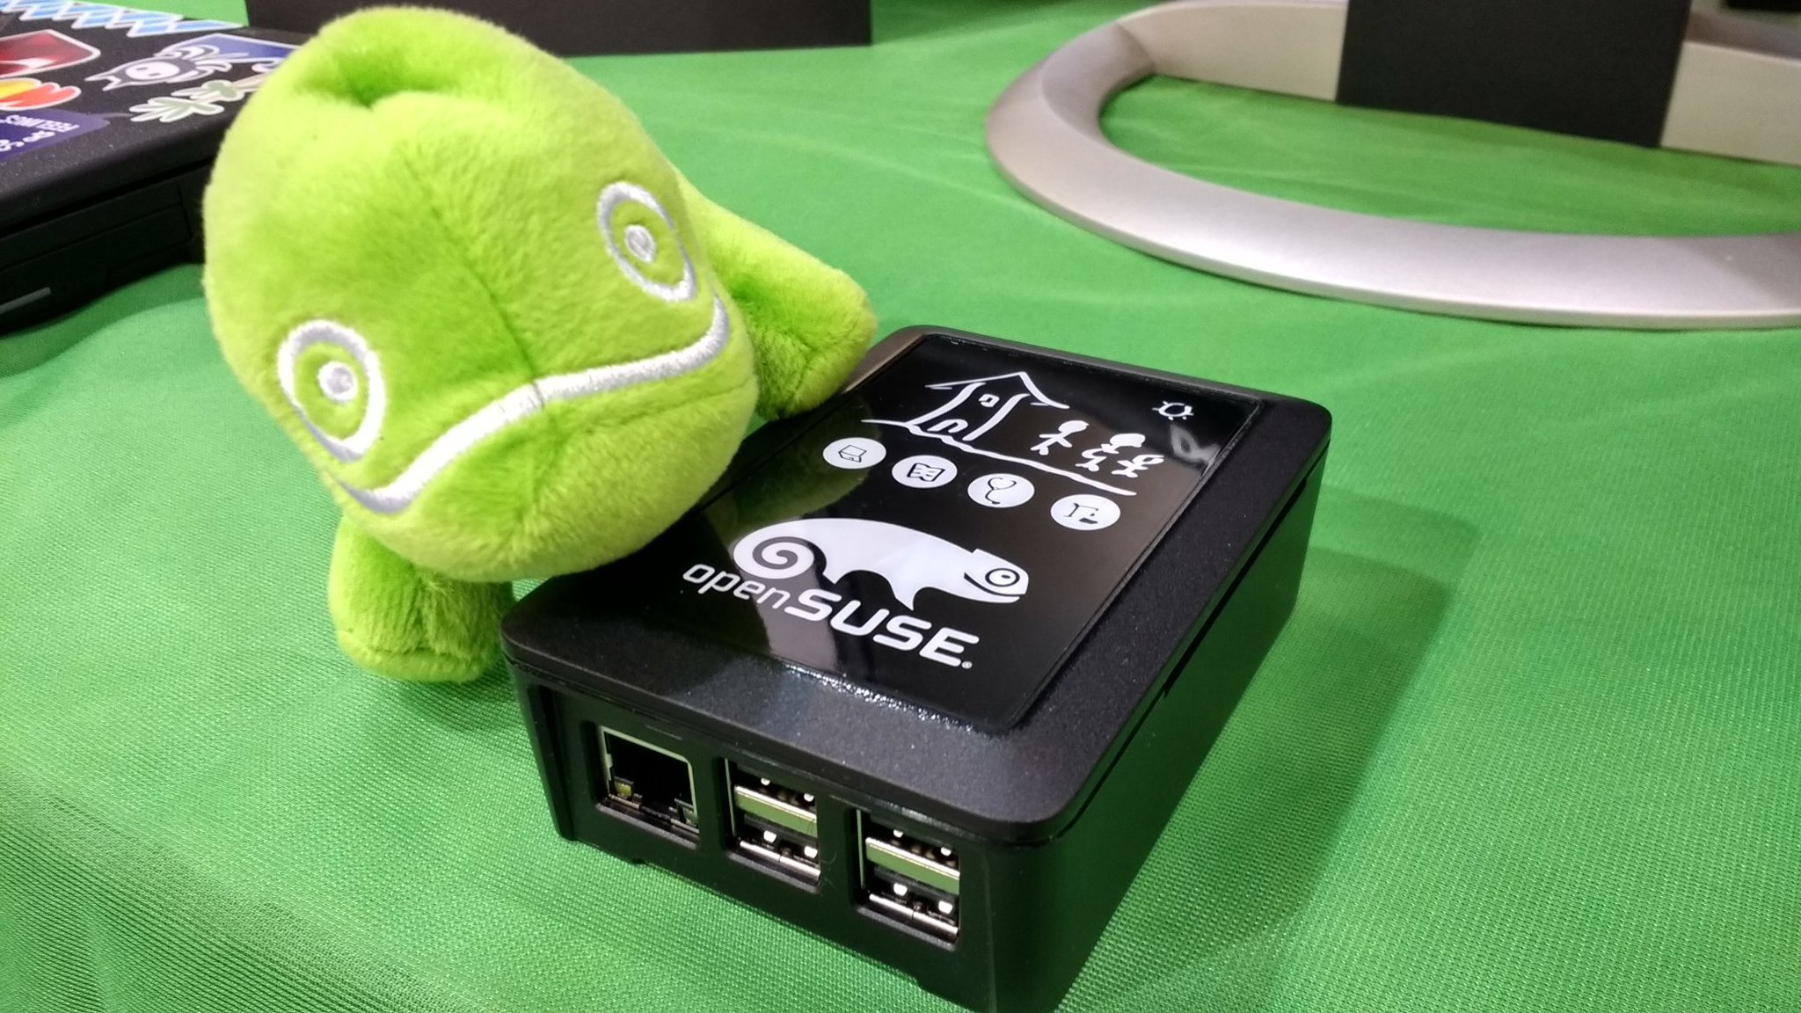
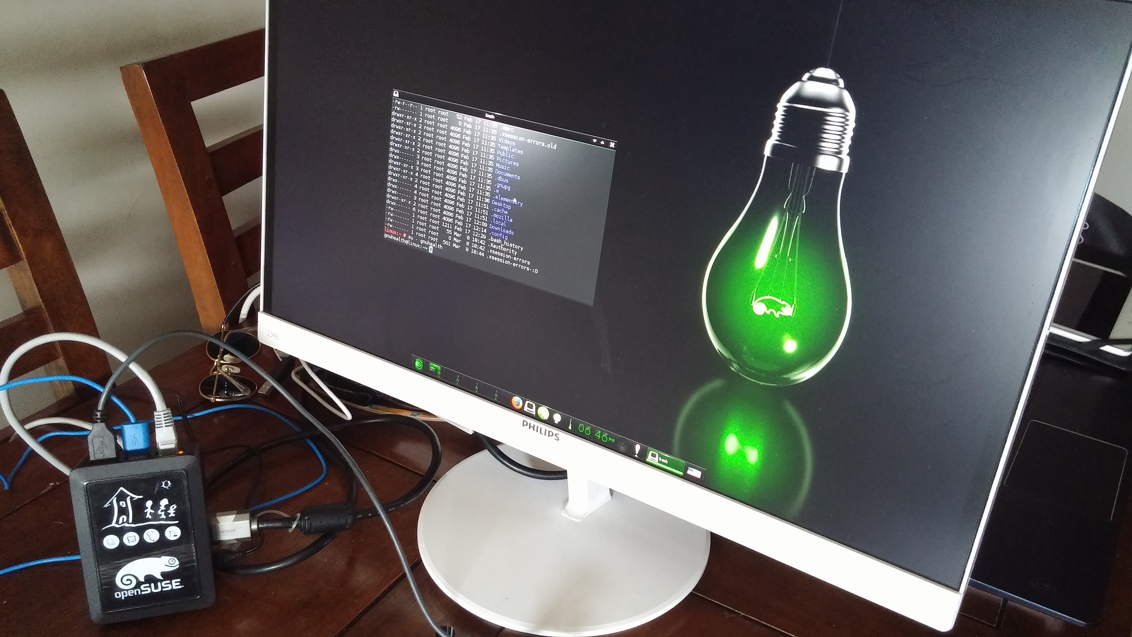
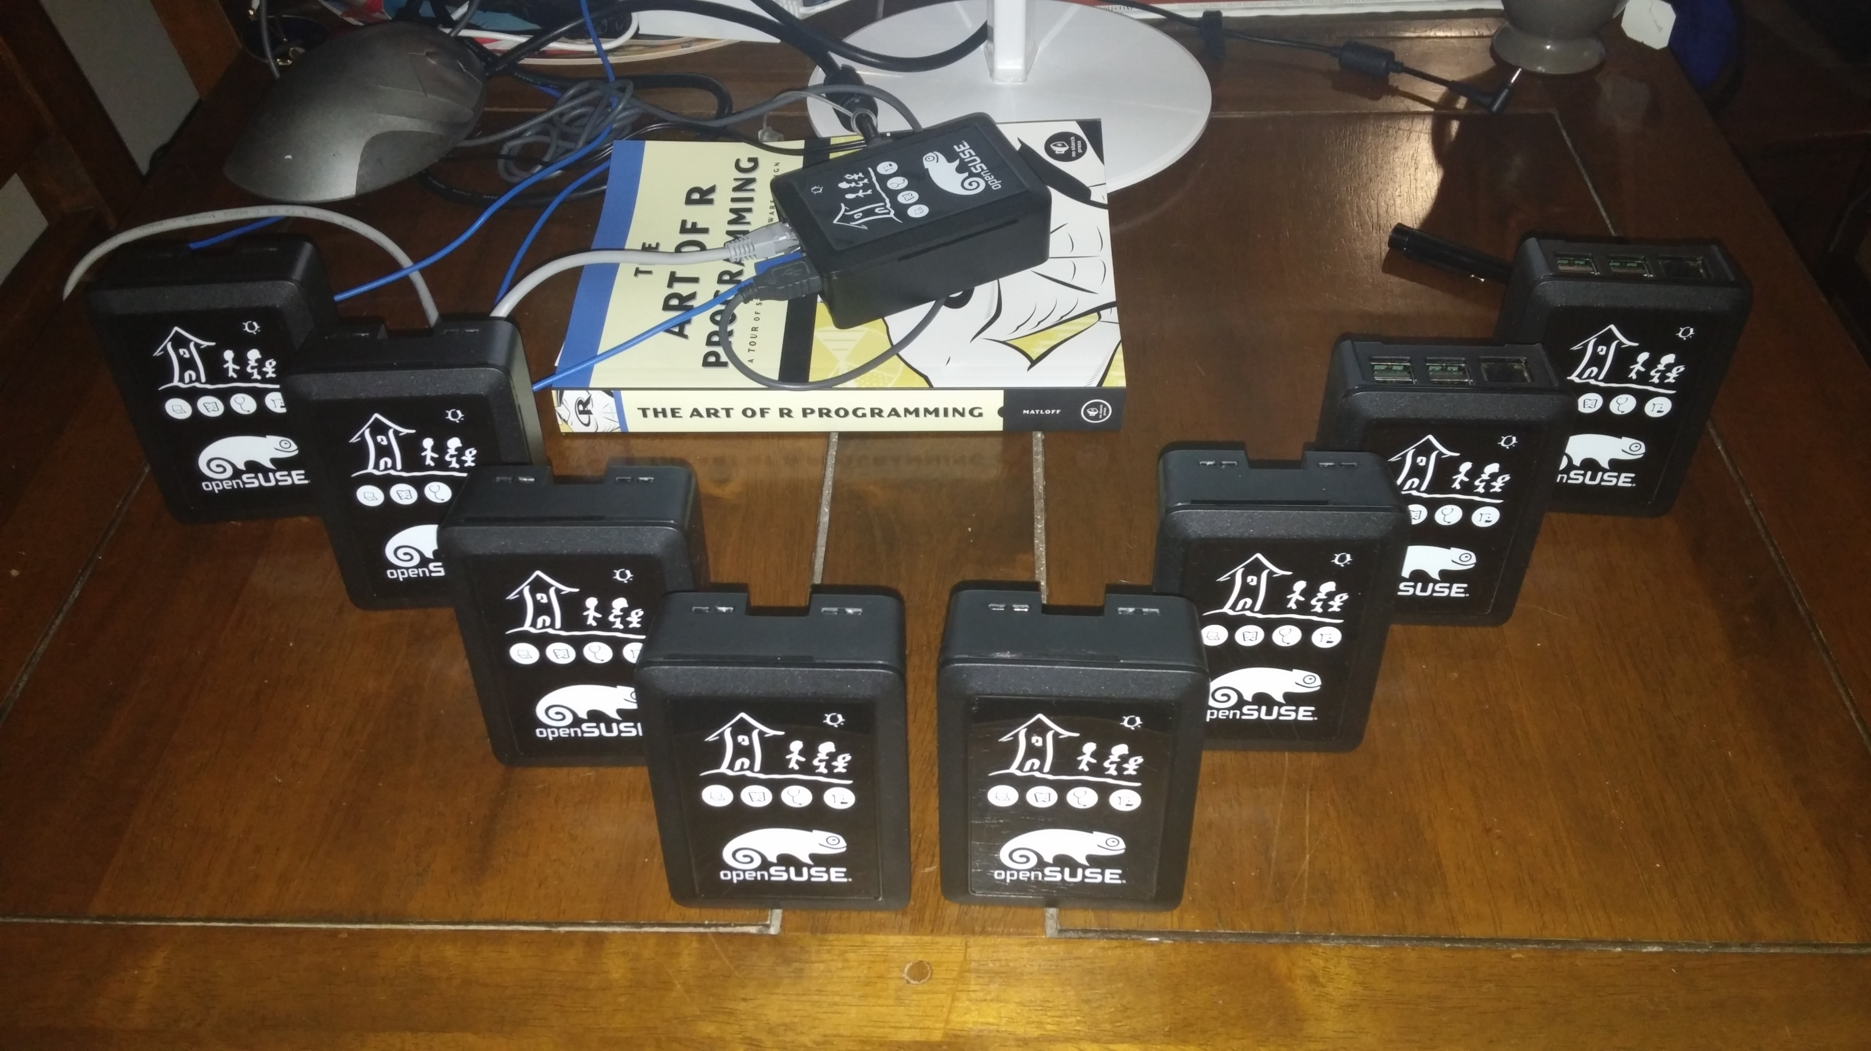
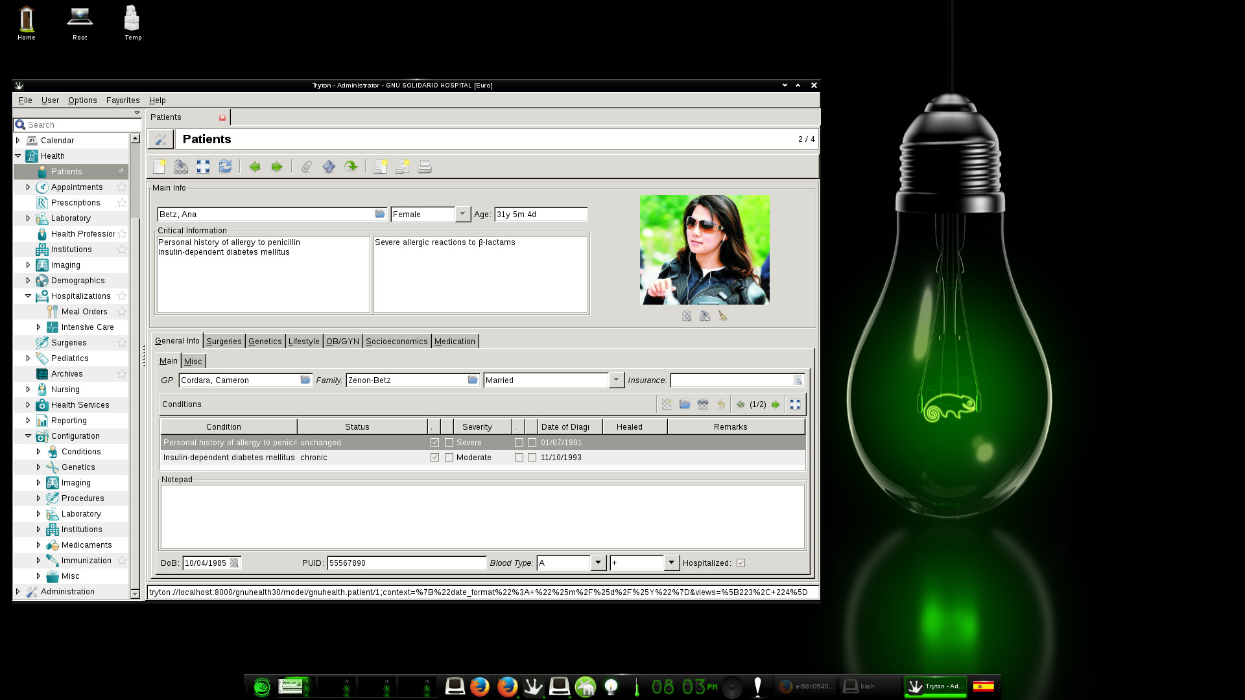
GNU Health & Raspberry Pi
Notes:
Lab interface
Domiciliary vector control
Autonomous GH system, data entry

Slide 40
GNU Health on openSUSE
Great support from openSUSE community
openSUSE ships GNU Health in Leap and Tumbleweed
Tested with openQA
1-click install & cookbook for setup
Cross-Plattform support (x86 / ARM)
Sponsor of GNUHealthCon!

Slide 41


We lost a friend…..
Live
DVD
Notes:
Dister
Studio allowed setup of live system in a defined state (no automatic update of packages!)
Studio light quite different in behaviour for complex systems
Volunteers wanted!

Slide 42







Looking for some more cool stuff to work on?
Live
DVD
Notes:
Package maintainer for Tryton
UX work: My GNU Health
LIVE-CD
Federation server
RasPi
Translation

Slide 43
Summary – What makes a great community?
Free Software is not only Take, but as well Give
Take the package and hide?
→ get involved
→ share experience
→ stay friendly
→ be helpful

Slide 44
Community involves humans
Treat them with respect otherwise they may get strange

Slide 45

See you at GNU Health Con 2018

Slide 46
Credits:
Maps: OpenStreetMap.org
Some slides and pictures adapted from Luis Falcon
Lao heat map by Mr. Somnuk Vorasarn (HealthCon2016)

